Slide 1

WELCOME
Community Information Session
Friday 19 September 2025
Presenter – Annette Nelson, CEO

Slide 2
Outline of briefing
Highlights for Stirling Hospital
Financial year performance
New Specialists
Community Engagement
Summary and questions

Slide 3
Stirling Hospital Highlights
Stirling Hospital currently has 84 employees, 41 Operating Specialists, 17 Consulting Medical Specialists
FY 2024-2025- admitted 5144 patients (↑23 % ) 4227 Day surgery patients and 917 overnight patients
Café sales were 7K higher than the previous year
Sleep study Lab 100% occupied since commencement in August 2024
Hand Hygiene compliance 84.6%
Patient Satisfaction 97%
Specialist recruitment – 9 since July 2024

Slide 4
Stirling Hospital Highlights
Online patient admission portal – compliance 90%
Community groups continued use of the facilities
Jan – Jun 2025 multiple GP engagement events
3 GP Educations Evenings with Better Medical or Summit Health Group
11 lunches at GP clinics introducing new Specialists

Slide 5
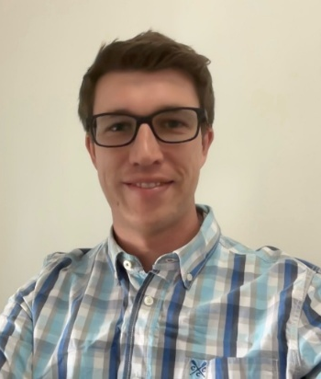
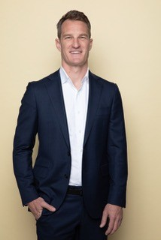
New Specialists ( Jan – Jul 2025)
Dr Justin Baker, Gastroenterologist
Dr Jesse Beumer, Bariatric and General Surgeon

Slide 6
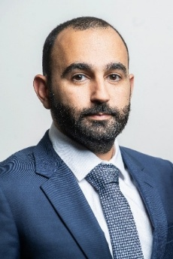
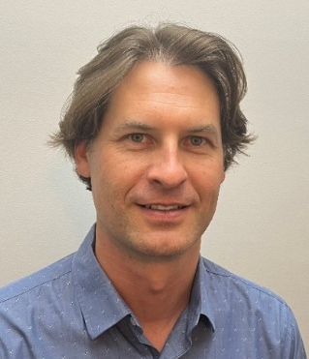
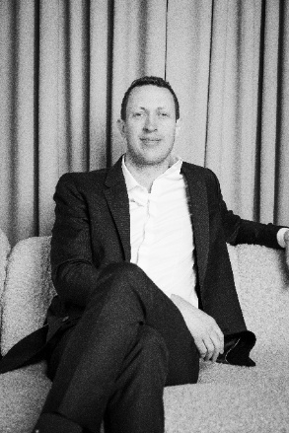
New Specialists
Dr Hani Saeed, Vascular Surgeon
Dr John Thomson, General Surgeon
Dr Lachlan Farmer, Plastic and Reconstructive Surgeon

Slide 7
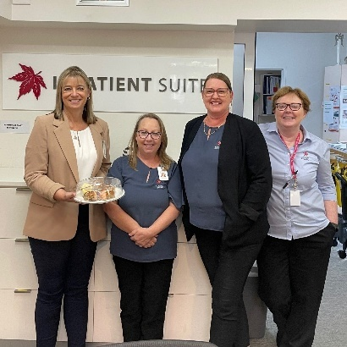
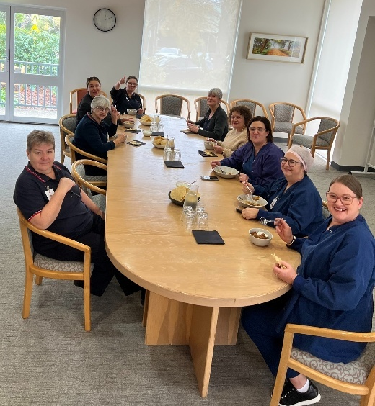
Caring for our teams
Staff Wellness Program, which runs a variety of events throughout the year as a way to show our appreciation for the dedication and hard work of our team.
Hot Cross Buns
Curry Day lunch – prepared by our catering team severe and served by our management team

Slide 8
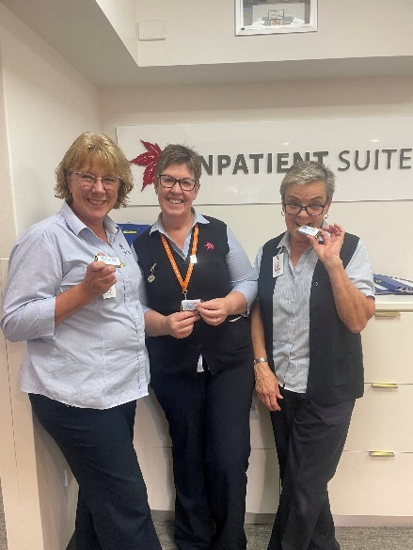
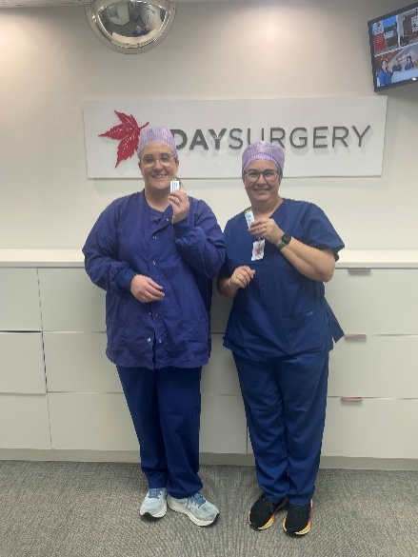
Team Recognition
Staff Recognition Days
World Sterilisation Day –recognition and appreciation of our Central Sterilisation Services Department (CSSD) team for their commitment to ensuring our surgical instruments are cleaned, sorted, packed and sterilised ready for us
Administrative Professionals Day - and we thanked our Administration team for their hard work to make sure the admission process runs smoothly for our patients
International Nurses Day - we celebrated our incredible Nurses for their skill, compassion, dedication, and commitment to delivering quality care to our patients every day.
Police Credit Union donated
Caramello Koala chocolates
for all the staff for Nurses day

Slide 9
Financial Performance
FY 24-25 financial performance audit is currently being finalised and will be available on the Australian Charities and Not for profits Commission (ACNC) for public access in coming months
Very pleasing to announce that the hospital did make a small operating profit
Operating model changed to reflect efficient activity
Contract reviews and negotiations
Ongoing collaboration with Specialists to optimise list efficiencies
$50K donations received by community groups ($5.5K from Witty Knitters and $25K by Stirling Community Shop) and from other fundraising activities, including $16,500 from the Quiz Night

Slide 10
Future plans
Business Development continues with discussions continuing with potential new Specialists – Breast/Endocrine Surgeon, Orthopaedic Surgeons, Dermatologist and Ophthalmologists
Assisting SA Health with public work – ENT and Gynaecology
Brand awareness campaign to promote the hospital services and Specialists
Strategic Planning event
Preparation and planning for the celebrations for the upcoming centenary in July 2027

Slide 11
Future plans
Ventilation upgrade for perioperative area – over Christmas period
Funded – a digital platform that connects generous SAs with local giving opportunities ( SA Philanthropy Network) - seeking donations to assist with the costs of the ventilation upgrade work
Ongoing celebratory Raffles
Stirling Hospital merchandise of socks and umbrellas

Slide 12
Ongoing Consumer Engagement
Successful volunteer program with 4 volunteers now
Consumer Representatives on Safety and Quality and Infection Control committees
Local community members on fundraising committees
Stirling Hospital Community Walk on 16 November 2025
Community groups holding meetings in the Boardroom
Community briefings twice a year
Quarterly newsletters
Planned participation in the Stirling Christmas Pageant
Stirling Markets in October 2025

Slide 13
How can the community assist?
Request your GP refers you to a Specialist that consults/operates at Stirling Hospital
Supporting our tenants – Radiology SA ( newly upgraded CT scan, Ultrasound, x-rays, mammography), Clinpath ( blood tests, ECG, blood pressure monitoring) Flex Physio – physio care and Pilates classes
Sharing your positive experiences with the community and encouraging others to use the Hospital and its services
Supporting our fundraising initiatives, like/follow our social media channels
Make a donation – bequests or targeted equipment purchases
Provide feedback and suggestions via the website or email

Slide 14
Questions or comments

Slide 15

Thank you for your support of Stirling Hospital

